Slide 1
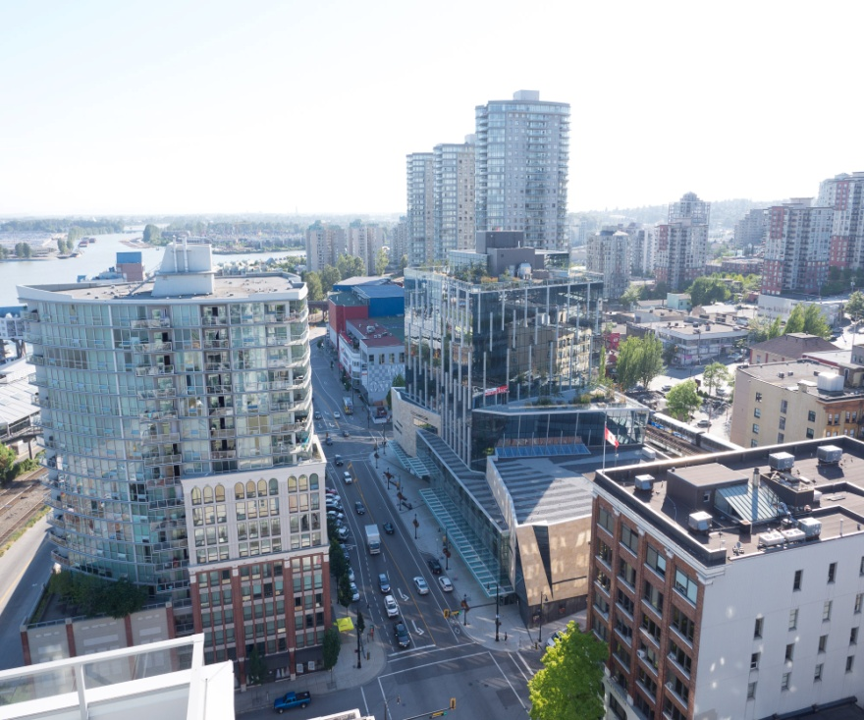
Addressing Elder Abuse through partnership between Family Services and Police Services
Reena Singh
Elder Abuse Victim Support Worker
Family Services of Greater Vancouver
Detective Jacqueline Frost
Domestic Violence Response Team
New Westminster Police Department

Slide 2
A few housekeeping tips
All attendees will be muted during the webinar. If you are listening to this presentation via phone, remember to mute yourselves with your mute/unmute button or by pressing *6
If you are experiencing issues, please let us know via the CHAT BOX or send an email to benedictes.cnpea@gmail.com
There will be a 10-15 minute Q&A at the end of the presentation. Send your questions via chat box or email at any time during the presentation.
The presenters’ contact information will be provided at the end of the presentation if you have further questions.
At the end of the webinar, you will be invited to take a short survey. Please take a moment to participate. Your feedback will help us plan our future webinars.

Slide 3
HOW TO JOIN
AUDIO VIA COMPUTER Use your microphone & speakers or headset (you will be muted during the presentation). If you are listening via phone, remember to mute yourselves with your mute/unmute button or by pressing *6
ANY TROUBLE?
- Double check the system requirements
- Ensure that your sound is turned on/up
- Leave the session and start over
AUDIO VIA PHONE
- Long distance number from Canada: +1 (647) 497-9374
- Toll free: 1 888 890 7881
- Long distance number from the US: +1 (510) 365-3331
- Access Code: 158-770-823 - Audio PIN: Shown after joining the training

Slide 4
HOW TO JOIN
Webinar online Post your comments/questions in the chat box
TECH ISSUE? You can still participate!
The Powerpoint is also available at this link
Post your comments via email: benedictes.cnpea@gmail.com

Slide 5
Your presenters
Reena Singh Victim Support Worker, New Westminster Police Department, Elder Abuse Unit, New Westminster Reena Singh is a Victim Support Worker employed by Family Services of Greater Vancouver working in partnership with the New Westminster Police Department. She has been working in police partnership roles since 2009. As the Elder Abuse support worker, she works on files where seniors are at risk for a high degree of violence or threat of violence within a relationship context. Reena uses a client-centered, strength-based, collaborative approach to establish relationships with clients, in order to help them explore options, connect them to resources, and discuss ways to enhance their safety and decrease their level of distress.

Slide 6
Your presenters
Detective Jacqueline Frost Domestic Violence Unit, New Westminster Police Department Jacqueline has been with the New Westminster Police Department since February 2004. Prior to joining the Domestic Violence Response Team in March 2015, Jacqueline worked as a uniformed Patrol Officer, Undercover Operator, Field Trainer, School Liaison Officer and as the Department’s Police Officer’s Physical Abilities Test Administrator. Jacqueline strives to continue the DVRT’s commitment to improving the overall quality and consistency of community and criminal justice system response to domestic violence and elder abuse.

Slide 7
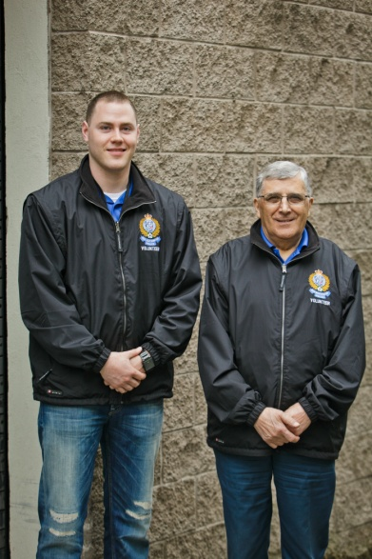
Elder Abuse: Definition
According to NWPS policy:
Any deliberate action or lack of action in a relationship of trust which results in harm to an older individual (not just >65).
Abuse can take many forms such as physical, emotional, financial, neglect, and self neglect.

Slide 9
History
Need for case tailored, specialized DV Services
Based on Edmonton model
DVRT established in 1996 (New Westminster)
2007 - 1st Elder Abuse Unit in Canada (Vancouver)
2008 - New Westminster Elder Unit starts

Slide 10
DVRT/Elder Abuse Unit: The Model
1 Detective from the
New Westminster Police
Service Detective
1 Community Counselor
From Family Services
Of Greater Vancouver
+
1 Elder Abuse Counselor
From Family Services
Of Greater Vancouver

Slide 11
DVRT Elder Abuse Service Description
The DVRT pairs a NWPD Detective with a FSGV Counselor to conduct specialized follow-up on cases of elder abuse in New Westminster.
Case-tailored plans are developed to increase safety for elder victims and hold abusers accountable to enhance a police response by balancing a support function with the traditional control function.

Slide 12
Continuum of Services: Elder Abuse
Referral
Patrol
Police Victim Services
Elder Abuse Unit offers services to victim and monitors offender until no longer required
Community Agency
Health Authority
Elder Abuse Counselor
Elder Abuse Detective
Hospital
Housing
Any other resource the victim requires
Mental Health
Public Guardian

Slide 13
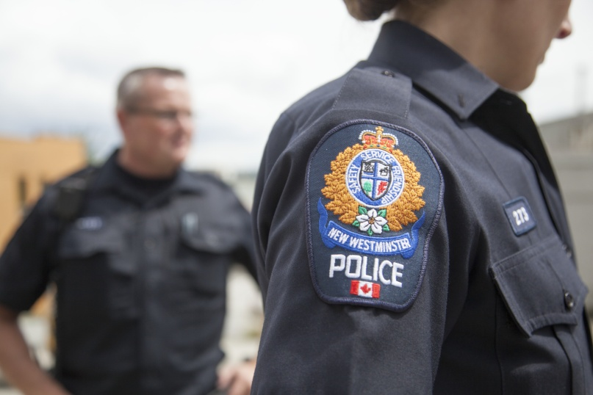
Partner Roles
Counsellor
Responds to needs of the victim (confidentiality)
Detective
Conducts investigation, monitors offender
As a Team
Conduct risk assessments
Brainstorm safety plans
Provide outreach

Slide 14
Counselor Responsibilities
Ongoing safety planning
Support, counselling, and information
Coordination of services
Liaising and providing advocacy within the community (e.g., RCH, Fraser Health, New West Mental Health, BC Housing, Public Guardian)
Practical assistance
Facilitating effective communication between families and community agencies

Slide 15
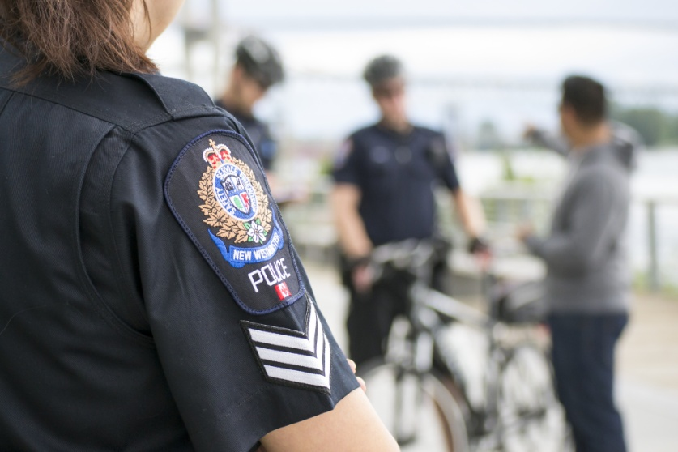
Detective Responsibilities
Conduct follow up investigation (e.g., historical)
Monitor post-offence behavior
Liaise with crown counsel (e.g., no-contact from jail)
Highlight offender with probation
Coordinate efforts between patrol and DVRT
Review all police files with people >65
Enforce legal conditions

Slide 16
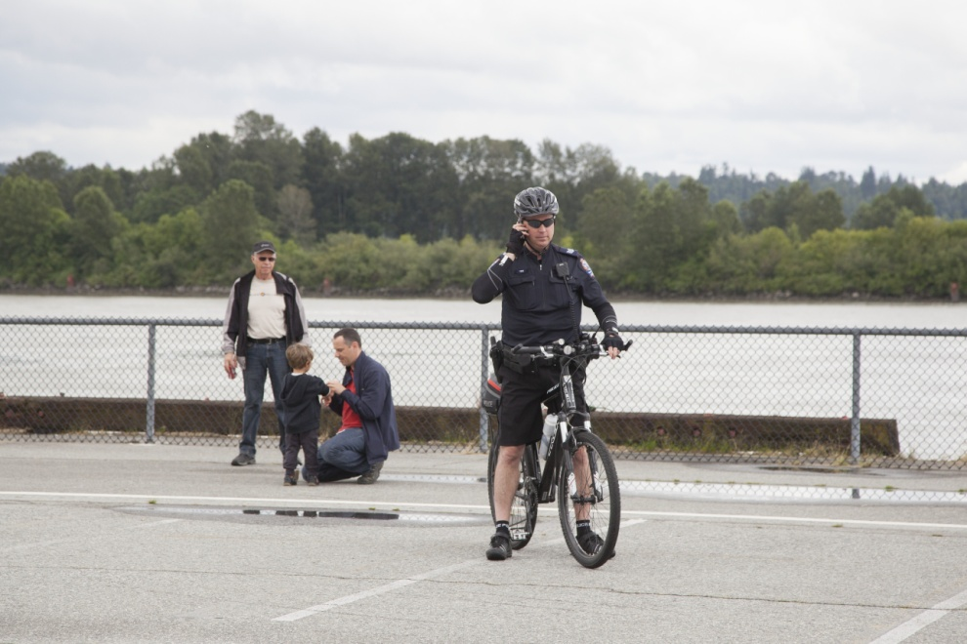
Challenges
Lack awareness of the problem
Shame
Freedom of choice to have contact with abuser
Barriers DVRT has connecting with victims due to isolation, disabilities, poor hearing, dementia/mental health, offender presence
Victim’s reluctance to involve police for fear of family member being taken away/put in jail
Cultural and language barriers (lack of understanding/police seen as authoritarian)
Legal system challenges (awareness/mis-trust/corruption)
Lack of resources for adult children with mental health/addiction issues who live with elderly parents
Lack of “end of life” education & planning
Improper police report ‘coding’ to capture elder abuse cases in PRIME
Only 1 Elder Counselor who works part-time and only 1 full-time Detective

Slide 17
Police Reporting (PRIME)

Slide 18
Strategies for supporting older adults experiencing abuse in a police practice context
The DVRT partnership (Counselor confidentiality/sense of autonomy)
Collaboration with other Police Resources such as Mental Health Liaison Officers
Collaboration with other Agencies (Crown/Probation, Fraser Health, etc)
Ongoing support/follow ups by Counselor
Training & Education for Police Officers
Coordinate efforts between DVRT and Patrol
Recommend Patrol refer all police files with people >65 to DVRT
Goal: change police policy to require mandatory follow ups when Members engage with elders

Slide 19
Questions? Contact Information
Detective Jacqueline Frost, DV and Elder Abuse Unit
jfrost@nwpolice.org
Reena Singh, Elder Abuse Counselor
rsingh@nwpolice.org
All located in the New Westminster Police Station
Phone (604) 525 – 5411

Slide 20
THANK YOU! Let’s stay in touch!
Please take a minute to answer a few quick questions about your experience of this webinar. Click on this link or copy/paste it in your browser: http://fluidsurveys.com/surveys/cnpea/cnpea-webinar-feedback/ Survey deadline: October 31, 2016 FIND OUT MORE ABOUT THE FAMILY VIOLENCE INITIATIVE AT CNPEA.CA
Twitter: @cnpea Facebook: www.facebook.com/cnpea
Questions/Comments: benedictes.cnpea@gmail.com

